Slide 1
Development of mathematical knowledge and logical thinking in education
Anna Ostrowska

Slide 2
COMPETENCES
Competencies are not permanent features, they change with experience and continuous learning throughout life.
They refer to your characteristics: knowledge, skills, abilities, motivation, attitudes.
Learning outcomes represent what the learner knows, understands, and can do as a result of their learning.

Slide 3
MATHEMATICAL COMPETENCES
Mathematical competences - the ability to develop and use mathematical thinking and attitude to solve problems and everyday situations.
An important role is played by the ability and willingness to acquire mathematical ways of thinking and presenting: formulas, models, charts, tables.
The development of mathematical competences in young children significantly contributes to their readiness for school..

Slide 4
COMPETENCES IN KINDERGARTEN
Kindergarten plays an important role in developing a child's mathematical conceptual sphere.
It must be combined with developing emotional resilience, practicing mathematical skills and continuous development.
Preschool age is special when it comes to the way of learning about reality. It takes place through the child's free experiences and involuntary learning.
It all starts with experiences. Naming objects and activities facilitates concentration and helps the child notice what is important.

Slide 5
COMPETENCES IN KINDERGARTEN
Mathematics classes with children should be based on fun, interesting tasks and games.
Games aid in the development of mathematical concepts by encouraging exploration, experimentation, experiential learning, and the opportunity to make mistakes.

Slide 6
Children become explorers!

Slide 7
Other competencies focus on practical situations, e.g. the ability to use counting in various everyday circumstances, solve problems and look for non-standard solutions.

Slide 8
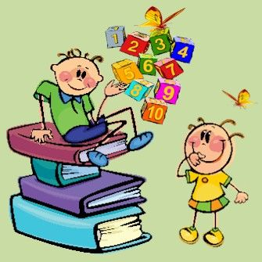
The cognitive area of ​​child development in terms of mathematical concepts includes 4 modules:
Sensory mathematics,
Mathematics,
Constructions,
Logic.

Slide 9
sensory mathematics
Intended for children 3-4 years old,
Develops the ability to analyze the external, visual features of objects,
It supports the child's acquisition of the ability to recognize and use basic sensory standards: color, shape, size.
Children are encouraged to analyze the importance of color, shape, size, relationships and their features,
Children learn to mix colors and name the resulting colors,
They will learn about a circle, square, triangle, oval and rectangle, then height, width and length.

Slide 10
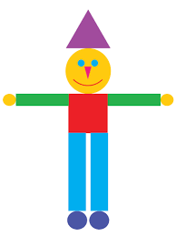
Exercise 1 - Colorful clown
The teacher presents the children with the silhouette of a clown made of colorful geometric figures (circles, squares, triangles and rectangles - the figures are of different sizes).
Ask the children to comment on the appearance of the clown.
What figures is it made of?
What can we say about these figures as they are?
How many triangles are there?
…

Slide 11
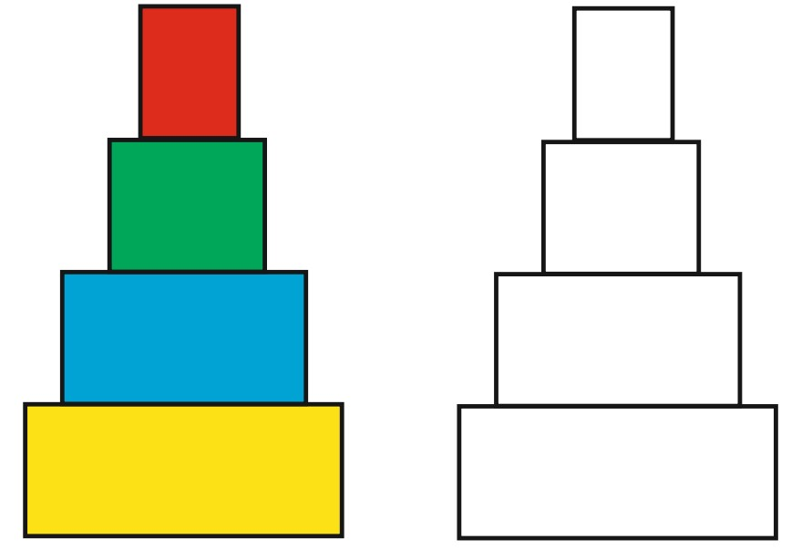
Exercise 2
Create a picture using geometric figures.

Slide 12
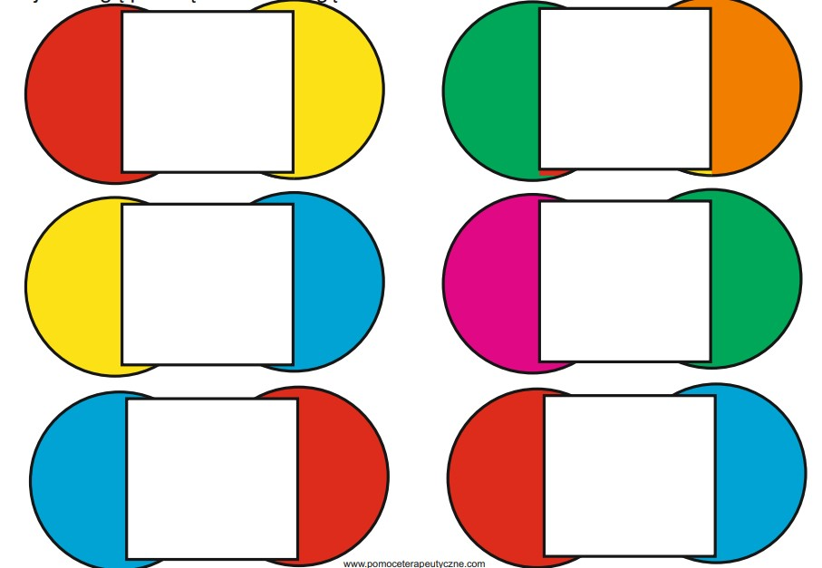
Exercise 3
Find your other half. Pay attention to the color.

Slide 13
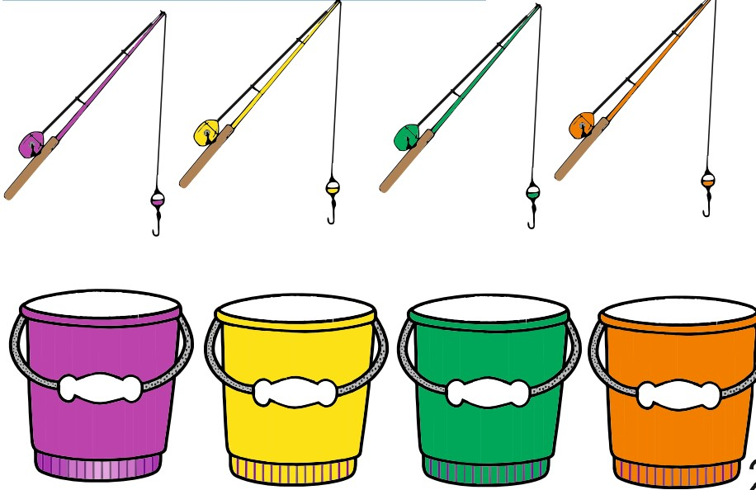
Exercise 4
Find fish of the same color. Match to your fishing rod.

Slide 14
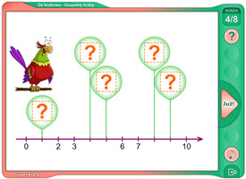
MATHEMATICS
Designed for children 5-6 years old,
Children learn to think, logical analysis, find mathematical relationships and relationships,
The main task is to help them learn the concept of size and quantity - length, capacity, weight.
Understanding mathematical relationships – more, less, equal.
A universal tool – the number line.

Slide 15
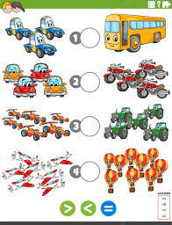
EXERCISE 1
Indicate whether the number of vehicles on the right is greater, less than or equal to those on the left.

Slide 16
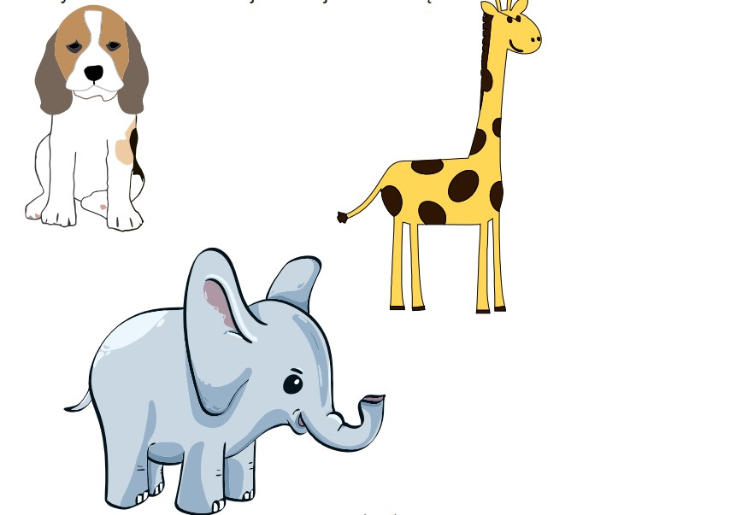
EXERCISE 2
Comparing sizes. Find smaller animals.

Slide 17
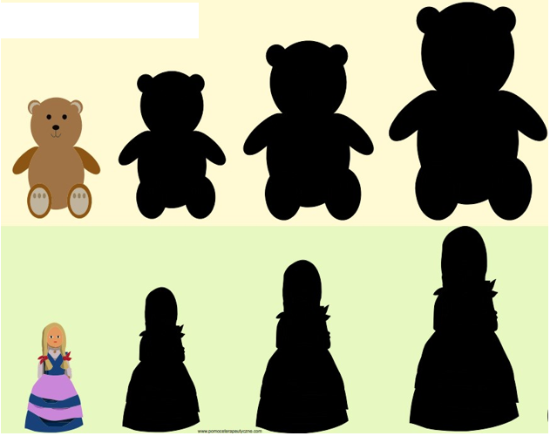
EXERCISE 3
Put the teddy bears and dolls in order.

Slide 18
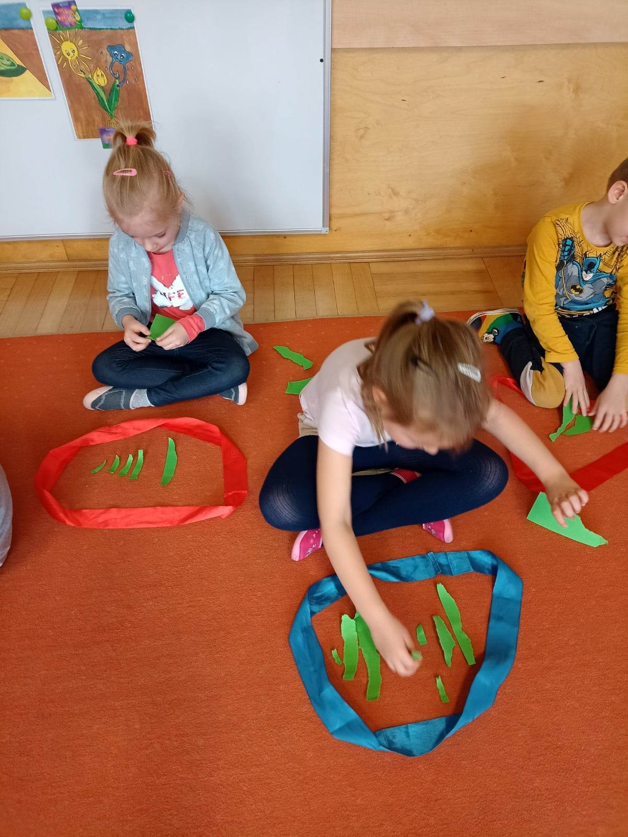
LOGIC
Grouping items,
Arranging them in space according to a certain rule,
Logical thinking at preschool age supports the development of mental abilities needed at school.

Slide 19
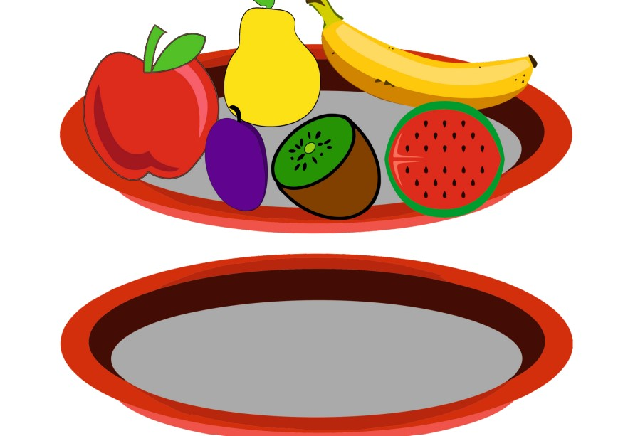
EXERCISE 1
Arrange the fruits according to the diagram.

Slide 20
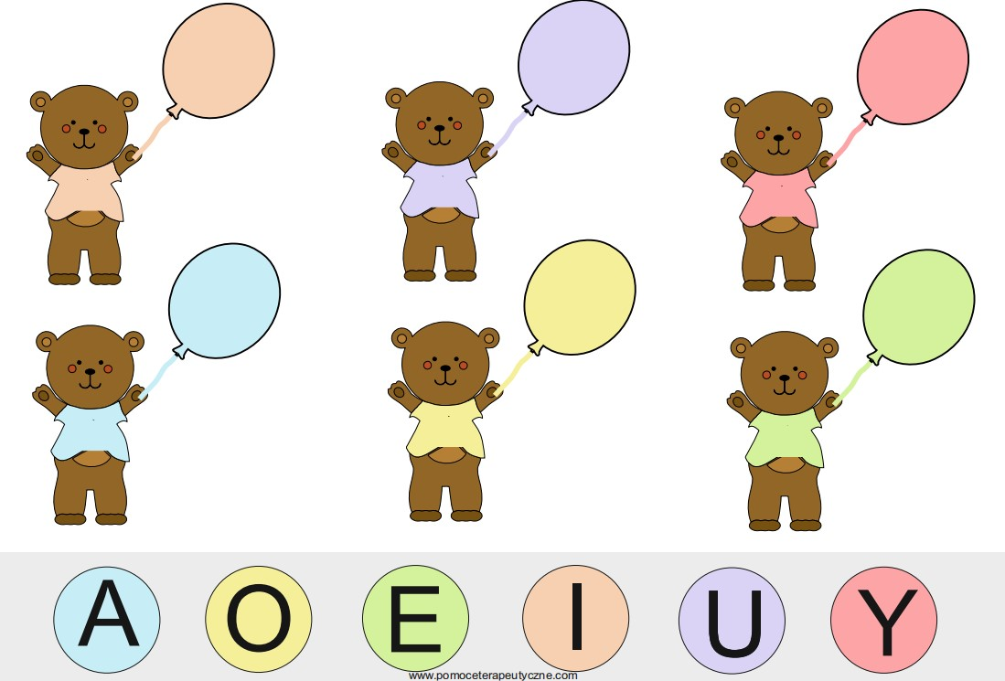
EXERCISE 2
Match the balloons to the teddy bears based on the legend.

Slide 21
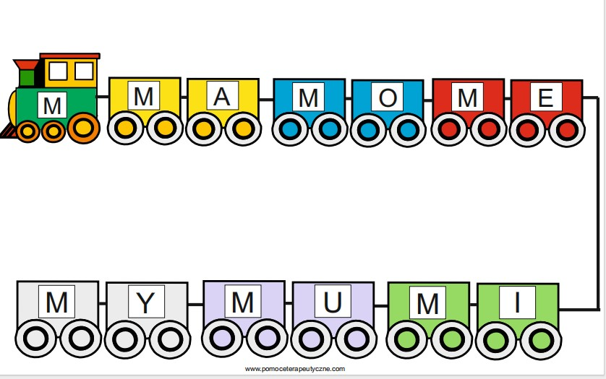
EXERCISE 3
Place the teddy bears in the wagons. Find the same syllables.

Slide 22
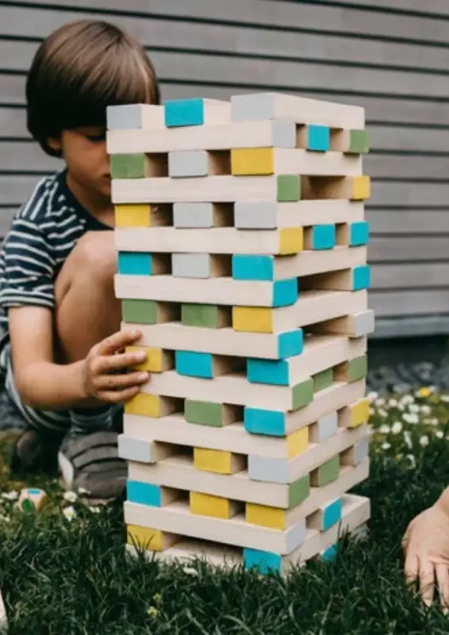
CONSTRUCTIONS
Develops planning skills and abilities - children talking about what they have planned, analyzing the structure of the subject,
Children use the drawn plan to build structures from blocks on their own,
They learn to look from different perspectives and sequences,
It prepares the child for planned action, learning, setting goals and seeking implementation.

Slide 23
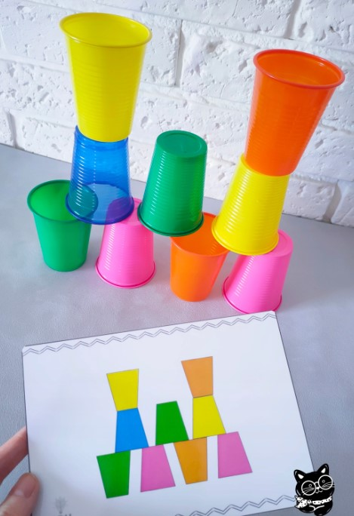
EXERCISE 1
Build a tower by code.

Slide 24
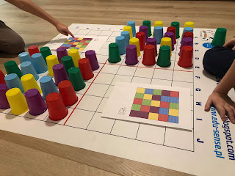
EXERCISE 2
Coding on the carpet.

