Slide 1
1ST THEME

Slide 2
AILE
Associação Internacional Lusófona para a Educação (Lusophone International Association for Education) is a non-profit organisation that works to promote development and cooperation in the area of training, especially in the fields of teaching, education, culture and social integration, encouraging cultural exchange and consequently the creation of economic and social opportunities, with a view to progress in education.

Slide 3
AILE exists because people believed that through education the place where they live could be better. But those people went further and decided to improve other places, and why not Portuguese-speaking countries? So our mission is to cooperate with society through projects that promote the social, economic and academic development of Portuguese-speaking communities.
The Mission

Slide 4
The Vision
Associação Internacional Lusófona para a Educação (Lusophone International Association for Education) is a non-profit organisation that works to promote development and cooperation in the area of training, especially in the fields of teaching, education, culture and social integration, encouraging cultural exchange and consequently the creation of economic and social opportunities, with a view to progress in education.

Slide 5
Values
Commitment to Education: promoting education for the whole of society, where we operate and where we may interact in solidarity.
Co-operation: developing together and sharing ideas. Every day, in the work we do, we promote actions where all generations can interact and learn from each other, recovering essential values such as respect and valuing each other's individual knowledge, whether they are children, young people, adults or seniors.
Sharing: acting through openness and transparency, establishing strategic ties that involve all those who believe in our mission.
Innovation: creativity is present every day in our work, and during the creative processes we carry out on a daily basis, innovation is the key to achieving our goals.

Slide 6
We focused on three key points
Promote and develop cultural exchange
Creating economic and social opportunities that favour education
Developing educational progress in Portuguese-speaking countries

Slide 7
Vectors
Vocational Guidance - Learning Competences
Psychosocial competences - Entrepreneurial competences
Degree of Support from Family and School

Slide 8
Workshops
Helping children study
Test anxiety
Bullying and Cyberbullying in schools
Positive discipline
Parenting styles
Me and others - how to overcome challenges
Conflict management
Skills promotion

Slide 9
2ND THEME

Slide 10
Educating with emotions
John Gottman, an American psychologist, in his book Emotional Intelligence and the Art of Educating Our Children - 1997, p.21, says: "We must orientate parents and teachers to be emotional coaches".
This quote is in line with what I believe in: taking care of emotions from an early age as a form of prevention and promotion, both physically and emotionally. When we work on Emotional Education in schools, we are working on prevention, since we spend a large part of our lives in a school environment.

Slide 11
Why not learn to be happy at school?
If we ask parents, "What do you most want for your child?" The common answer is "Happiness". But are we raising our children to be happy? Are you raising your child for a life of well-being and happiness?
Teaching and learning how to build a happy and balanced life is related to using personal strengths in life projects, having learnt optimism, having the right way of thinking, solving problems, maintaining emotional ties with friends and family and having a sense of meaning in life.

Slide 12
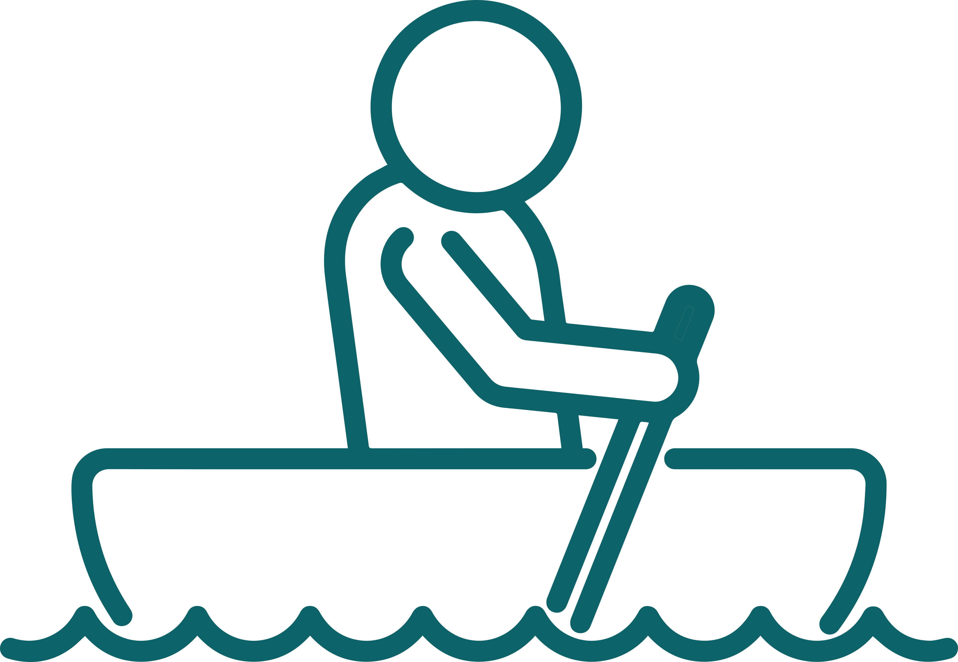
How to work on Behaviours/Emotions
Behaviours
Values
Personality

Slide 13
Knowing Knowing
What it is
Own
How
How
Competence
Know-How
Knowing How to Want

Slide 14
Discover
Transform
Conquer
Skills profile
Self-knowledge
Instructions
Knowledge delivery
Methods
Strategies
Results
Autonomy
Self-Confidence
Self-Esteem
Self-Motivation
Ability to choose

Slide 15
Hertzberg System
High
Incompetence
Conscious
Believe
Competent
Conscious
Do
Conscious
Incompetence
Unconscious
Know
Competent
Unconscious
Own
Capacity
Low
High

Slide 16
Learning motivation system
Booshing
Motivation
Establishing
Self-Motivation
Practical orientation
to the usefulness of learning
Make believe
and progress

Slide 17
It is an integral part of Emotional Education to be aware of one's own emotional states and to have the resources to manage these states. To become emotionally educated is to be more aware of one's own emotions, to be able to deal with disturbing emotions and to be able to maintain healthy personal interactions.
The aim is to prevent psychopathologies resulting from the inability to deal with emotions, such as anxiety, violence, depression, eating disorders and psychosomatic problems.
AILE exists because people believed that through education the place where they live could be better. But those people went further and decided to improve other places, and why not Portuguese-speaking countries? So our mission is to cooperate with society through projects that promote the social, economic and academic development of Portuguese-speaking communities.
Reflect: "Do you bring up your child like this?"

Slide 18
All our behaviours are learned, just like dealing with emotions. Behaviours that we need to learn and that we use in activities to develop emotional education:
internalisation exercises (breathing and relaxation);
conversation circles;
active listening;
challenging negative automatic thoughts;
learnt optimism;
empathy;
self-control
etc.

Slide 19
Emotional education is based on four central words:
Perceiving-Naming-Verbalising-Behaviour
Realise the emotion you are feeling in yourself/in the other person;
Naming your own emotion (self/other);
Verbalise properly (self/other);
And deciding what to do (what behaviour to have/realising that one's own behaviour interferes with the behaviour of others).

Slide 20
Remember that it's easier to change the plans for a house while it's still in its foundation or blueprint. Well-being and happiness can be built, which is why it is important that the activities developed are continuous, because only through intentional activities can we build well-being. Neuroscience has shown that experience modifies the brain and we are able to transform our internal world by educating our emotions. "emotional plasticity".
AILE exists because people believed that through education the place where they live could be better. But those people went further and decided to improve other places, and why not Portuguese-speaking countries? So our mission is to cooperate with society through projects that promote the social, economic and academic development of Portuguese-speaking communities.

Slide 21
Our current society hasn't learnt how to be happy. We haven't learned to take care of relationships, we haven't learned that our own emotions have an impact on the behaviour of others, let alone how to live a meaningful life. Let's educate our children and young people so that they can have well-being, and well-being consists of dealing with emotions properly. There are many people who study at the best schools, with excellent results, and they haven't learnt how to take care of their emotional health; that's why they're unhappy.
Do you know of any cases like this? I'm sure you do.

Slide 22
Knowing how to deal with emotions is the best gift we can give our children and young people. Teach them how to express their emotions appropriately, within limits. Let's also teach them that gratitude and optimism form the path that leads to happiness and well-being. Society doesn't teach us to be happy with what we have, but to always want more, and more, and more.... So we're never happy with the life we have and we live in constant competition rather than co-operation. We don't learn to be grateful for the small or big things that happen in our lives. I ask again:
"Are we raising our children to be happy?" Here's a thought. Be happy!

Slide 23
THANK YOU

